Slide 1
Food Safety and Adulteration
Assoc. Prof. Martina Fikselová,PhD.
Department of Food Hygiene and Safety
Faculty of Biotechnology and Food Sciences, SUA Nitra, Slovakia

Slide 2
Content
Food safety- current situation
Role of the European Food Safety Authority
Rapid Alert System for Food and Feed
Adulteration of foodstuffs
Authenticity of foods
Examples: case of honey

Slide 3
Introduction
Food commodities have always been vulnerable to fraudulent admixture or adulteration with cheaper inferior materials.
Economic adulteration is a long-term problem affecting the food industry.
European union protects consumers and producers in terms of quality assurance, food labeling in its laws and necessary measures.

Slide 4
Several food scandals
1981 “ Toxic oil syndrome ” : Consumption of rapeseed oil denatured with aniline caused the death of hundreds of people
1985: Ethylene glycol, a frost protection agent was added to wine to upgrade it to table-wine quality
1985: Usage of spoilt eggs in pasta products
Since 1980s: Mad cow disease
1994: Lead tetroxide in chilli powder
1996 : Synthetic “ apple juice ” concentrate
1999 : Dioxins in feed
2001: Hormones, vaccines and antibiotics in pork
2002 : Antibiotics in honey from China
2003 : Adulterated wine (extended with water; added alcohol, coloring, and sugar) from Eastern Europe
2004: Banned dyes used in spices
2013: Meat adulteration scandal in Europe; foods advertised as containing beef were found to contain undeclared horse meat, as much as 100% of the meat content in some cases

Slide 5
Food scandals in V 4 countries
Poland: milk powder contaminated with rodent poison, chicken meat infected with Salmonella, road salt in food, antibiotics in honey ....
Czech Republic: methanol scandal in alcoholic beverages (more than 30 deaths)
Hungary: colored pork and sold as beef
Slovakia: yoghurt with glass...

Slide 6
Food origin ????
Meat
Eggs
Animals born in Holland
The same animals fed in Slovakia
Slaughtered in Hungary
Meat sold in Slovakia and labelled as „made in EU“
Eggs from foreign illegal breed with Salmonella
Repackaged and marketed in Slovakia
Labelled with the Slovak identification

Slide 7
Food Safety
is a set of measures in the field of plant health, animal health and welfare issues, in the field of food and feed production, this is achieved by implementing of safety principles on all components of the food chain and hence the final food.

Slide 8
Hazard
means a biological, chemical or physical agent in, or condition of, food or feed with the potential to cause an adverse health effect;
Factors which contribute to potential hazards in foods include improper agricultural practices;
poor hygiene at all stages of the food chain;
lack of preventive controls in food processing and preparation operations;
misuse of chemicals;
contaminated raw materials, ingredients and water;
inadequate or improper storage, etc.
• Microbiological hazards;
• Pesticide residues;
• Food additives;
•Chemical contaminants, including biological toxins;
• Adulteration....

Slide 9
EFSA
The European Food Safety Authority (EFSA) is the keystone of European Union (EU) risk assessment regarding food and feed safety.
EFSA provides independent scientific advice and clear communication on existing and emerging risks.

Slide 10
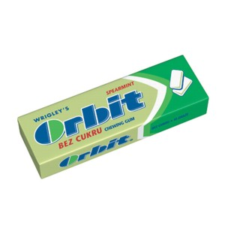
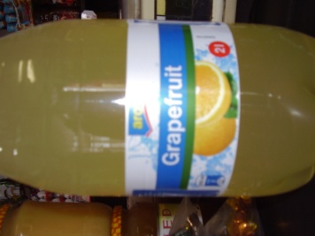
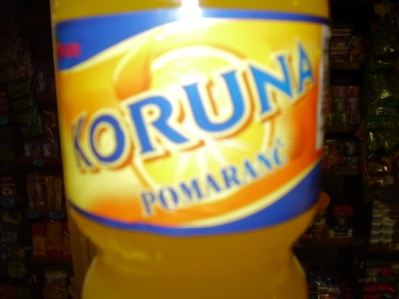
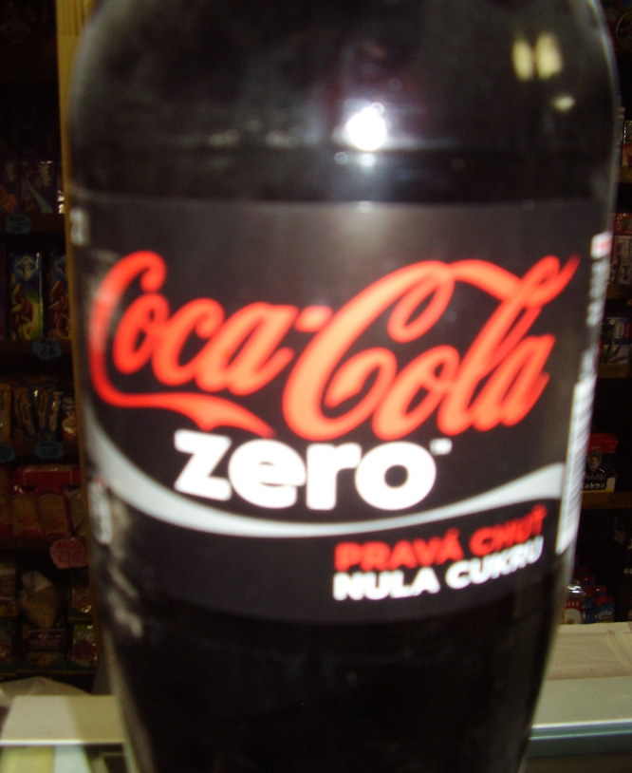
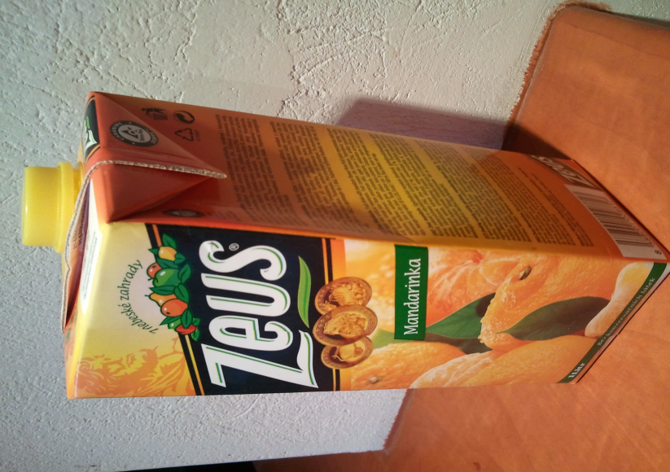
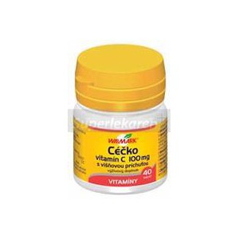
Aspartame

Slide 11
RASFF in the EU and Slovakia
Dátum hlásenia | Krajina hlásenia | Referenčné číslo | Typ, názov výrobku | Dôvod hlásenia | Krajina pôvodu | Podklady pre oznámenie
17.12.2012 | Slovensko | 2012.1736 | pomelo | methidathion (0.057 mg/kg - ppm) | Čína cez Nemecko | Úradná kontrola na trhu / výrobok bol skonzumovaný
14.12.2012 | Slovensko | 2012.1729 | maslo | zmenené senzorické vlastnosti ( tmavozelená a ružová farba) | Požsko | Úradná kontrola na trhu / informácie o distribúcií nie sú k dispozícií
12.12.2012 | Slovensko | 2012.1717 | údené bravčové kosti z karé | benzo(a)pyrén (11.0 - 53.6 ľg/kg - ppb) | Požsko | Úradná kontrola na trhu / informácie o distribúcií nie sú k dispozícií
30.11.2012 | Slovensko | 2012.CLB | sušené hrozienka | ochratoxín A (22.66; 22.59; 12.0 ľg/kg - ppb) | Turecko | kontrola na hraniciach - zadržanie zásielky /
- an effective tool to exchange information about measures taken responding to serious risks detected in relation to food or feed.

Slide 12
Selected members of RASFF
EUROPEAN UNION
European Commission
European Food Safety Authority (EFSA)
POLAND
- Glówny Inspektorat Sanitarny (Chief Sanitary Inspectorate)
CZECH REPUBLIC
- Czech Agriculture and Food Inspection Authority
HUNGARY
- National Food Chain Safety Office Directorate for Food
Safety Risk Assessment

Slide 13
Traceability
the ability to trace and follow a food, feed, food-producing animal or substance intended to be, or expected to be incorporated into a food or feed, through all stages of production, processing and distribution,
can relate to the origin of materials and parts, the processing history, the distribution and location of the product after delivery,
the standard EAN/GTIN product code has 13 digits. For smaller sized products there is a short version of the EAN/GTIN code the EAN 8

Slide 14
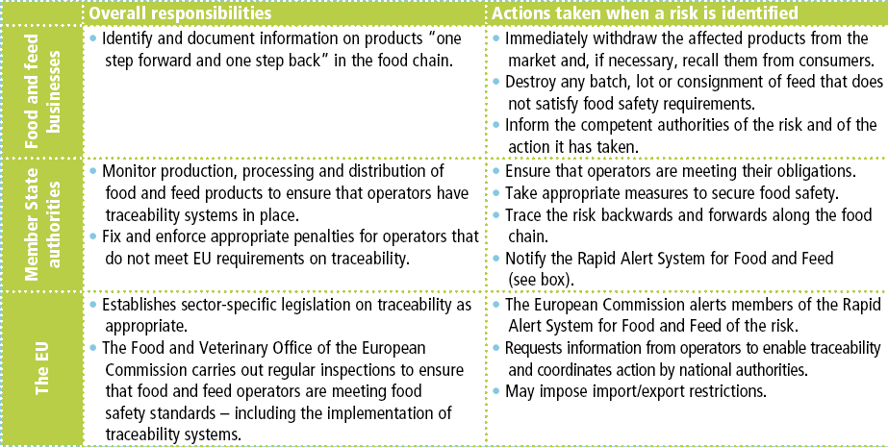
In practice, how it works....

Slide 15
Adulterated food by the Food Code
is food, whose appearance, taste, composition, or other attributes has been changed and its quality decreased, but is offered to the consumer as the usual food under common name or by other false name.
another definition often used „deliberately placing on the market for financial gain foods that are falsely described or otherwise intended to deceive the consumer“.

Slide 16
Food adulteration
In recent years, there has been a growing interest among consumers in the safety and traceability of food products.
In particular there is an increasing focus on the geographical origin of raw materials and finished products, for several reasons including specific sensory properties, perceived health values, confidence in locally-produced products...

Slide 17
Selected detection techniques
product | adulteration | method
Fruit juice | Dilution with water | Brix,
Fruit juice | Sugar addition | GC, SNIF/NMR
Meat | Cheaper meat addition | Methods of molecular biology
Natural vanilla extract | Synthetic vanillin addition | SNIF-NMR
Soya | Genetic modification | DNA methods
Plant oil | Cheaper oil addition | Chromatography, MS
Wine | Water dilution | O IRMS
Alcohol | Wrong origin | IRMS, SNIF/NMR
Honey | Cane and corn syrup addition | C IRMS

Slide 18
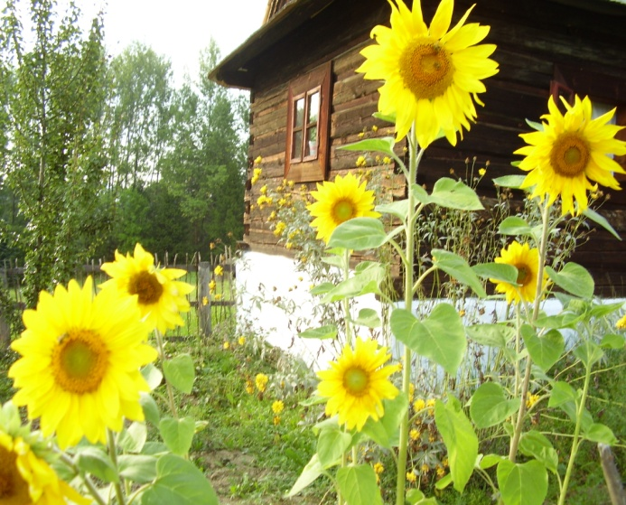
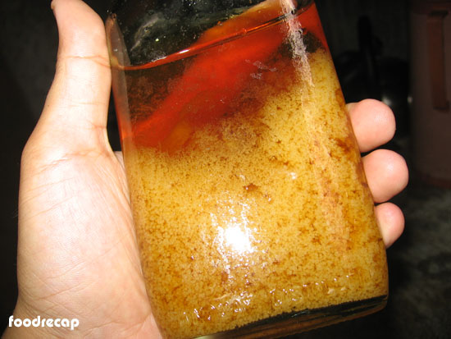
Case of honey

Slide 19
Honey
40 % of the European honey market depends on imports; whereas the EU’s lack of independence of honey supply leads to significant volatility in prices, resulting also from adulteration in the global market, as the past opening up of the EU market for honey from third countries
Artificial honeys are products labeled as honey, may be fraudulent if they were made to simulate honey, e.g. heating sucrose with lactic acid to hydrolyse it to a mixture of glucose and fructose, with an aqueous extract of corn pollen added to give it the flavour and aroma of bee honey.

Slide 20
Prove of honey adulteration
1. proof of syrup, sugar or malt extracts adding,
2. pollen analysis,
3. sugar determination,
4. enzyme determination,
5. proof of additives- food colorants, etc...

