Slide 1
CURRENT STATE AND POST-CRISIS DEVELOPMENTS OF EU-V4-CIS TRADE:
PERSPECTIVE TOOLS TO ENSURE SUSTAINABILITY
Dr. Anna IVOLGA
Stavropol State Agrarian University
Stavropol, Russia

Slide 2
Main topics to be described:
Current market of EU-CIS trade
Main tendencies of its post-crisis development
Major approaches and tools to ensure sustainability of such development
Analysis of main exporting and importing countries for each analyzed product group
Comparison of main consequences of WTO accession for separate CIS countries (Kazakhstan, Ukraine, Kyrgyzstan, Georgia and Moldova)
Overview of the WTO threats and opportunities for Russian agriculture, and trade with agricultural products globally
State support of agricultural production in Russia and CIS and its influence on volumes, directions, structure and effectiveness of international trade with agricultural products

Slide 3
Introductory Provisions:
EU-CIS trade flow is one of the world’s biggest.
CIS is the relevant EU-27 trade partner.
WTO influences strongly on EU-CIS trade, especially with Russia’s accession to WTO in 2012.
Following the slump in 2009, the EU bounced back with over 20% growth in exports, to reach record levels in 2010-2011.
The EU’s trade balance improved to the extent that it emerged from recession as a net exporter in 2010, for the first time since 2006.
The €6 billion agricultural trade surplus is largely due to expansion in the value of exports, driven by stronger demand for final products.
While EU-27 is recovering after global recession, CIS countries still feel many difficulties, especially in unfamiliar condition of trade integration and open markets.
Along with a wide range of advantages given by the WTO system to CIS economies, there are series of problems and challenges related mainly to the alleviation of access to internal markets for foreign goods, decreasing competitiveness of CIS producers, wave of bankruptcies, increase of unemployment and decrease of living standard

Slide 4
International Trade in 2008-2011s:
International trade during post-crisis 2008-2011s was developing multi-directionally.
In consequence of significant growth of global prices for raw goods the increase of global trade monetary value in 2011 was 19%.
It is lower than 2010 (22%) when international trade experienced active volume recoveries after economic crisis of 2008-2009s.
However, such a significant growth should be primarily explained by the growth of global prices – as the quantum index of international trade in 2011 increased only on 5% (14% in 2010).
This was substantially lower than the pre-crisis levels when the sustainable growth of international economics volumes was observed – up to 10% annually during the preceding decade.
The indicative trend of the post-crisis international economic development is the advanced growth of interregional trade, observed in 2006-2011 even despite the economic recession.
This shows the strengthening differentiation of labor on macroeconomic level.
The highest increase of exports was observed for the regions specialized in raw goods supplies.
The best imports dynamics was in the developing countries (as a result of global imports appreciation) and again the same “raw” regions – as a result of growth of their revenues on global market and enlargement of their effective demand.

Slide 5
EU-CIS Trade in 2008-2011s:
EU-CIS trade flow remained one of the worlds biggest in 2009-2011s.
The annual volume of interregional trade almost tripled – from €109.7 bln. in 2000 to €330.0 bln in 2011.
However, the significant drop of exports and imports in 2009 has to be noticed as a result of global economic recession
Following rapid (up to 30% annually) growth of interregional trade volumes in 2009-2011 let us to forecast the recovery of exports and imports volumes as of 2008 level even in 2013, as well as the achievement of horizon of €250 bln. imports and €170 bln. exports in 2013.
In 2001-2011 (except «crisis» 2008-2009) annual increase of EU-27 imports from CIS countries was 10.1%.
Such high level can be explained primarily by the growth of imports volume from Russia as well as imports increase from Kazakhstan, Azerbaijan and Ukraine

Slide 6
Picture 1 – Interregional EU-27-CIS trade in 2001-2011, bln. €

Slide 7
EU-27 imports from separate CIS countries:
Russia’s share in the structure of foreign trade turnover between EU-27 and CIS countries remains significant, including the period of global economic recession and considering the non-membership WTO status of Russia until 2012.
Russia’s share is 79% of EU-27 imports from CIS countries and 71% of EU-27 exports to CIS countries.
Structure of Russian export to EU is homogenous during last decades – over 78% Russian exports to EU-27 is mineral fuel (2011).

Slide 8
Picture 2 – Dynamics of EU-27 imports from some of the CIS countries in 2001-2011, %

Slide 9
EU-27 exports to separate CIS countries:
EU-27 exports to Russia is much more diversified, mainly consisting of machineries, equipments and transport vehicles (44% in 2011).
During the same period of 2001-2011 the annual average increase of EU-27 exports to CIS countries was 13.9%.
The given increase was provided primarily by the growth of exports to Russia, Ukraine, Belarus and Kazakhstan.

Slide 10
Picture 3 – Dynamics of EU-27 exports to some of the CIS countries in 2001-2011, %

Slide 11
World Trade in Agricultural Products:
World trade in agricultural products in 2010 increased 12% compared to 2008 and reached record highs.
Increased trade in agriculture was due increased product demand from major emerging economies compared to previous years.
World agricultural trade reached an all-time high, at least 12% (expressed in Euros) above the previous record set in 2008.
The impact of the economic crisis led to a contraction of 6% in global agricultural exports in 2009 but they rebounded by 20% in 2010

Slide 12
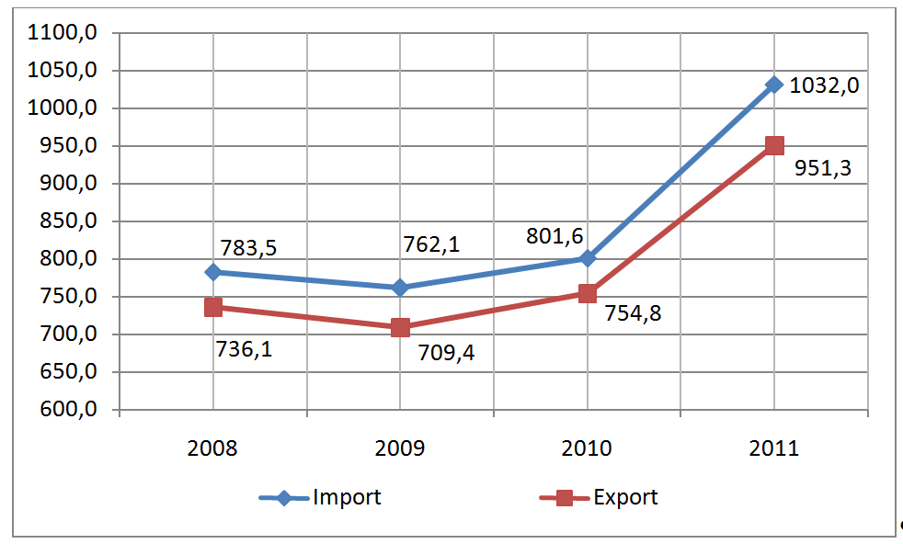
Picture 4 – World export and import of agricultural products in 2008-2011, bln. €

Slide 13
World Trade in Agricultural Products (cont.):
World main exporters of agricultural products in 2011 are
EU-27, USA and Brazil.
These 3 countries increased their export volumes in 2011 in comparison with 2008.
China took the 4th place in 2011, while exports from Canada and Argentina grew in much lower rates, comparing to exports from China.
China, having the world’s biggest population, is able to provide sufficient internal requirements of agricultural products and food and, moreover, to increase export volumes.

Slide 14
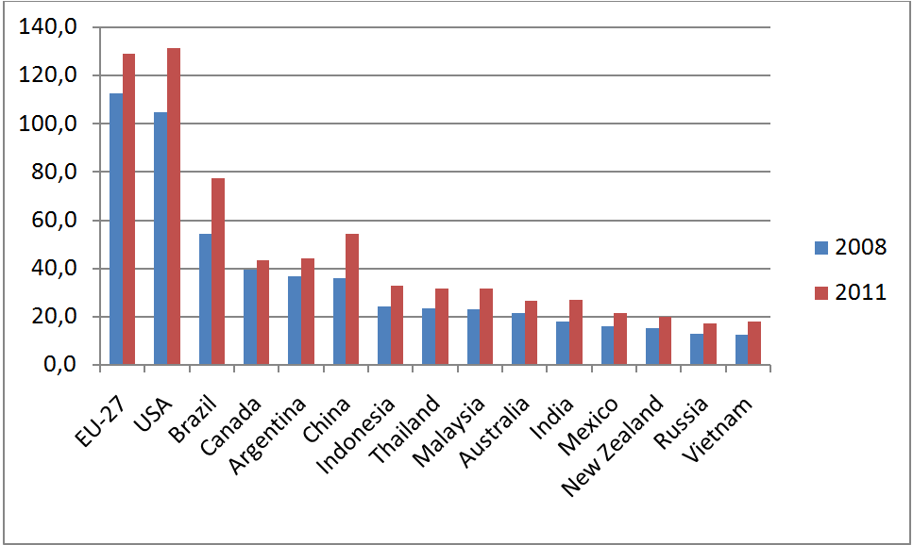
Picture 5 – World main exporters of agricultural products in 2011, bln. $

Slide 15
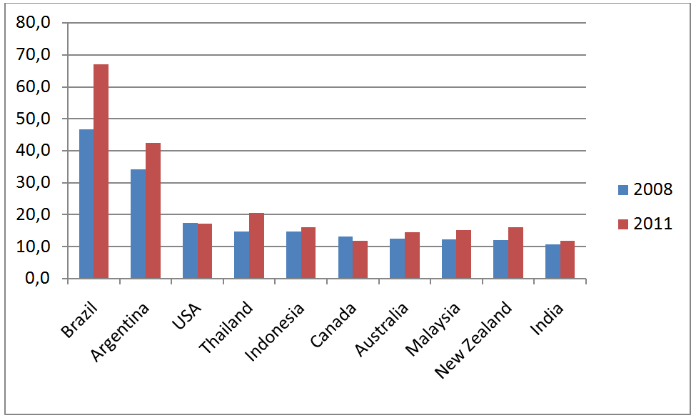
Picture 6 – World main net-exporters of agricultural products in 2011, bln. $

Slide 16
World Trade in Agricultural Products (cont.):
EU-27, USA and Japan remained world 3 leading importers of agricultural products in 2011.
China took 4th place with almost 30% growth of import volumes during 2008-2011s.
Russia, being the world’s most potential agricultural producer, is increasing its import of agricultural products (5th leading importer in 2011).

Slide 17
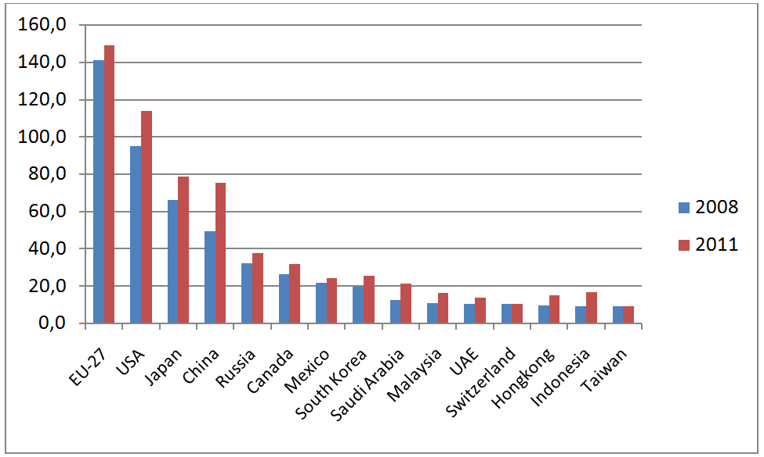
Picture 7 – World main importers of agricultural products in 2011, bln. $

Slide 18
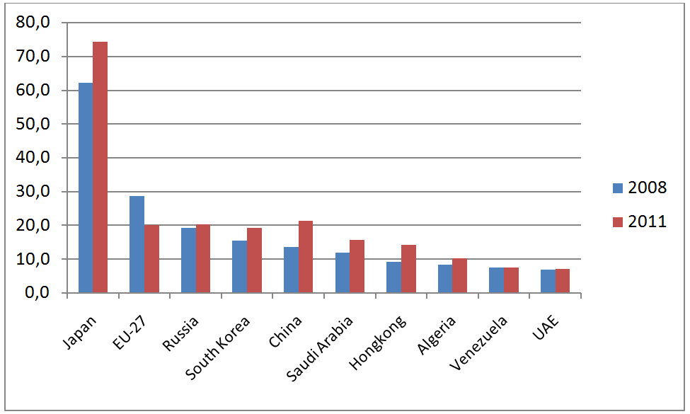
Picture 8 – World main net-importers of agricultural products in 2011, bln. $

Slide 19
World Wheat Market (exports):
World trade of wheat in 2011 grew up on 11% (the maximum growth among the considered goods), and in absolute expression it amounts to 14 million ton (only trade of iron ore increased more considerably).
Considerable growth of trade was promoted by wheat big crops in leading exporters, first of all in the CIS countries (in Russia and the Ukraine long-term maxima of wheat gathering were fixed) in 2008-2011.
The USA continue to remain the leader though in 2011 their separation from Canada which has taken the second place was minimum current decade (indicators of the countries have made 22 and 19.5 million ton correspondingly).
The third place in 2011 was divided by France and Russia (17 million ton both), Australia (15 million ton) closed the first five

Slide 20
Picture 9 – Main wheat exporters in 2011, million ton

Slide 21
World Wheat Market (imports):
Egypt which in 2011 reached a new maximum in purchases
(9 million ton) has been the leader in wheat import for several years.
Besides it, the list of first five of the countries-importers in 2011 included Italy, Spain (6.5 million ton), Algeria and Iran
(5.5 million ton).
The most considerable growth of import among leading buyers was noted in the EU (+5 million ton), Bangladesh (+2.5 million ton) and Philippines (+1.5 million ton).
Essential decrease in import was fixed at Morocco
(-1.5 million ton) and Japan (-1 million ton).

Slide 22
Picture 10 – Main wheat importers in 2011, million ton

Slide 23
World Corn Market (exports):
World trade of corn in 2011 decreased by 5.5%, and in absolute expression decrease amounts to 5.5 million ton.
Increase of use of corn for biofuel in the USA, the leading world exporter, the smallest in the last several years crop yield Argentina, the second key exporter, and also the amplified competition to cheap fodder grain from the CIS countries promoted trade decrease.
The largest exporter of corn historically is the USA, providing about half of global trade (48 million ton in 2011).
The second place last years confidently is occupied by Argentina (8.5 million ton in 2011), in 2011 also Brazil (8 million ton), Ukraine (7 million ton) and France (6.5 million ton) were included into the first five of the countries.
The greatest increase in export in 2011 was shown by the Ukraine (+4.5 million ton) and the EU (+2.5 million), Argentina (-7 million ton) and the USA
(-6 million ton) strongly reduced shipments

Slide 24
Picture 11 – Main corn exporters in 2011, million ton

Slide 25
World Corn Market (imports):
Japan is traditionally the leader in corn import at countries level. Import in this country throughout 2000s is stable and is within
16-17 million ton limits in a year.
In 2011 purchases in the world market Mexico, Republic Korea (7.5 million ton both), Egypt (5.5 million ton) and Taiwan
(4.5 million ton) were marked according to their purchases amount.
Iran (+0.7 million ton), Syria (+0.6 million ton) and Egypt
(+1.5 million ton) have shown considerable growth of import from leading buyers in 2011.
Big reduction is fixed at the EU (-4.5 million ton), Mexico
(-1.8 million ton) and Republic of Korea (-1.7 million ton).

Slide 26
Picture 12 – Main corn importers in 2011, million ton

Slide 27
World Sugar Market (exports):
World trade of sugar in 2011 grew up to 1.5 %, and in absolute expression — to 1 million ton.
The global result has reached a new historical maximum. Trade expansion was promoted by sugar cane huge crop in Brazil while there was reduction of volumes of its processing in ethanol and growing demand for sugar from the developing countries.
Brazil, last years providing 30–35 % of global trade (24 million ton in 2011) and having the repeated superiority over any other country acts as the leading exporter of sugar from the middle of 1990s.
Also the first five in 2011 included Thailand (5.5 million ton), Australia, France (3.5 million ton both) and Guatemala and the USA (2 million ton both) divided the fifth place.
Brazil (+5 million ton) has shown substantial growth of export in 2011, from other it is possible to mark the EU and Colombia
(+0.6 million ton).

Slide 28
Picture 13 – Main sugar exporters in 2011, million ton

Slide 29
World Sugar Market (imports):
The leading sugar importer at countries level in 2000s usually were the USA or Russia, however in 2011 they were outstripped by India
(4.5 million ton), among irregular importers where owing to a poor harvest there was a strong deficiency of sugar.
The USA have taken the second place (4 million ton), and Russia thanks to a good harvest of sugar beet has sharply lowered purchases of sugar and according to its amount moved to the end of first ten countries.
The first five in 2011 was added by Republic of Korea (2.5 million ton), Great Britain (2.5 million ton) and the United Arab Emirates
(2 million ton).
The most considerable growth of import from leading buyers was shown by Indonesia and Mexico (+0,5 million ton both). Huge decrease in purchases is fixed in Russia (-1.5 million ton) and EU
(-1 million ton).

Slide 30
Picture 14 – Main sugar importers in 2011, million ton

Slide 31
EU-27 Trade in Agricultural Products:
The EU as well as the other top exporters all benefited from buoyant markets.
Following the slump in 2009, the EU, the US and Brazil bounced back with over 20% growth in exports, to reach record levels in 2010-2011.
The EU’s trade balance improved to the extent that it emerged from recession as a net exporter in 2011, for the first time since 2006.
The €6 billion agricultural trade surplus is largely due to expansion in the value of exports, driven by stronger demand for final products, as the EU’s key trading partners come out of recession and higher prices for commodities and intermediate goods

Slide 32
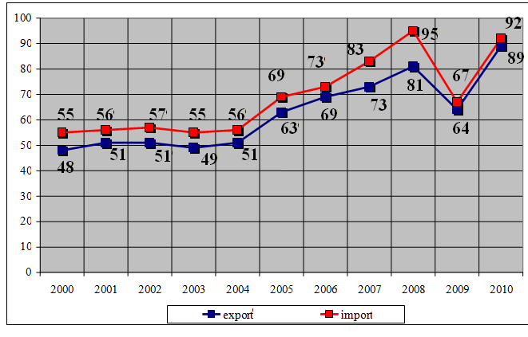
Picture 15 – Dynamics of agricultural exports and imports by EU-27, bln. €

Slide 33
EU-27 Trade in Agricultural Products (cont.):
The EU remains by far the world’s biggest importer with imports worth €83 billion in 2008-2011, well ahead of the US.
EU imports grew by 9% in 2011 though they remain 5% below the peak of 2008, when they reached €88 billion.
This is a result of the sharp drop of over 12% in 2009 after two years of very strong growth of over 13% per year.
The EU’s share of global imports was over 19% in 2009. US imports grew strongly by 17% in 2011, having suffered a less severe decline (just 5%) than the EU in 2009.

Slide 34
EU-27 Trade in Agricultural Products (cont.):
The EU’s trade balance continued to improve in 2011 to the extent that it switched from being a net importer with a trade deficit of €2.5 billion in 2009 to a net exporter, for the first time since 2006, with an agricultural trade surplus of over €6 billion.
The surplus is largely due to growth in the value of exports after the contraction of trade in 2009 linked to economic crisis and the drop in commodity prices.
The EU and the other top exporters all benefited from buoyant export sales.
The EU’s export profile has changed little in recent years. Final products and other products together account for 69% of the value of EU exports in 2008-2011, while intermediate products and commodities represent 20% and 9% respectively.

Slide 35
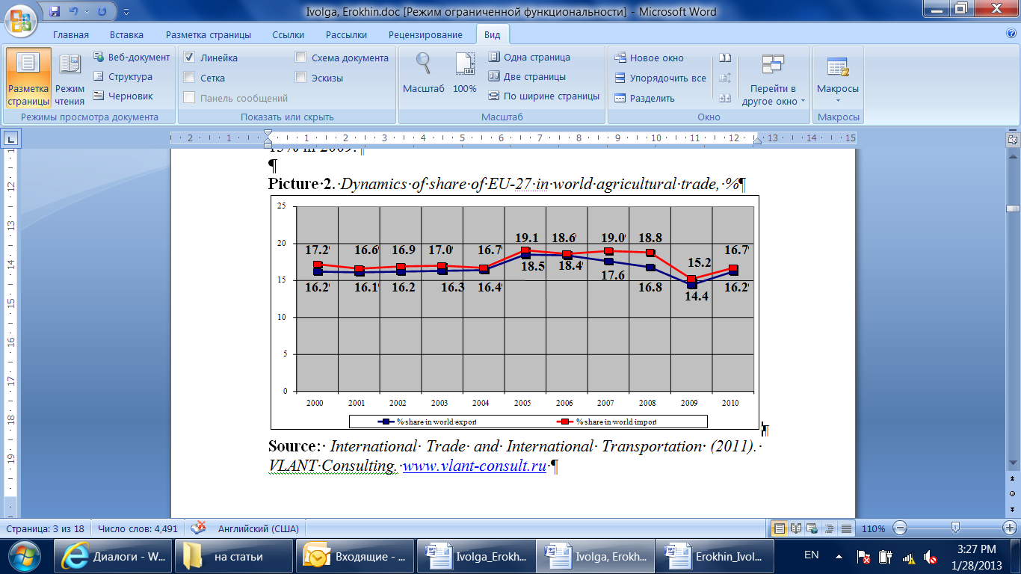
Picture 16 – Dynamics of share of EU-27 in world agricultural trade, %

Slide 36
WTO membership influences for development of trade in agricultural products:
Kazakhstan
Ukraine
Kyrgyzstan
Georgia
Moldova
Russia

Slide 37
Kazakhstan:
Kazakhstan’s experience can be recognized as one of the most successful among other CIS countries.
According to the World Bank data, investments to agriculture are on the second place according to their effectiveness after the oil production in Kazakhstan.
The state provides the following privileges to stimulate the development of domestic agricultural production and food processing:
  cheapening of combustibles and lubricants,
  lowering of interest rates on credits in the second level banks,
  leasing for special machinery and processing equipment,
  purchasing of seeds is subsidized on 40%, their production – from 40% to 100%.
The government supports projects related to growing of fruit trees, production of mineral fertilizers, development of pure-strain stock-breeding.
The volume of state support of agriculture had grown 5 times since 2002 and had reached $924 mln., among them $146 mln. for subsidies, $355 mln. for credit programs.
The related institutions had been established: JSC “KazAgro”, JSC “KazAgroFinance”, JSC “Fund of financial support for agriculture

Slide 38
Ukraine:
The main problem for Ukraine is how to support the domestic agricultural producers.
Liberalization of the trade regime had caused the active interpenetration of the domestic Ukrainian food market with imported agricultural and food products.
Since WTO accession, the growth of import volume of agricultural product has been reaching 11%. The growth of import volume was caused by import deliveries of meat (43% in the structure of increase).
Volumes of meat deliveries had grown up to 6.5 times. It is especially necessary to distinguish the growth of import deliveries of grain and sugar – traditional domestic products in Ukraine.
The excessive liberalization and openness of the Ukrainian domestic market are testified by the data on the GDP structure. During 2000-2004 the total export and import steady exceeded 100% (export exceeded import).
Since 2006 the opposite picture had been observing: import exceeded export, i.e. the national economics had transferred to the import-dependent model of foreign trade relations

Slide 39
Ukraine (cont.):
Ukraine’s agriculture turned out to be exceedingly exposed to the influence of the negative factors of the global crisis because of the high dependency on the external trade.
In 2005-2011 import volume of vegetables and fruits to Ukraine had sharply increased ($860 mln., growth in 4.2 times comparing to 2005).
At that the quantum of import of fruits and vegetables had increased on 77%. It is especially important to note the growth of import of agricultural products traditionally produced in Ukraine.
In 2005-2011 import of potatoes, cabbage, onion, carrot, tomatoes and cucumbers had increased in 18.5 times (up to 190 thousand tons), apples, pears, cherries and apricots – almost in 5 times (up to 210 thousand tons).
Since January 2011 Ukraine (according to the undertaken WTO obligations) finagled the import duties on alcohol beverages. Consequently the domestic production of grape wine decreased on 41.3%.
Import volume of swine meat increased in 2.9 times, the import share of this product on the domestic market reached 40%.
Thus, during three years of WTO membership Ukraine has lost more than has gained.

Slide 40
Picture 17 – Ukraine’s trade in agricultural products in 2002-2011, bln. $
export
import
balance

Slide 41
Kyrgyzstan:
Rapid entry to WTO has caused the negative consequences because of the insufficient working out of the accession obligations. For example, Kyrgyzstan has not preconditioned the status of the developing country thereby losing the related preferences.
Establishing of the equal conditions for domestic and foreign products on the national market became one of the most negative consequences for Kyrgyzstan.
This negatively redounded upon the domestic industry in the period of reconstruction.
Kyrgyzstan’s accession to WTO closed the domestic market for investments opening it for imported products.
This led to the growing raw-material orientation of the Kyrgyzstan’s economic and prolonged recession in its various sectors, including agriculture (which share in the national economic is 80%).
Entering WTO Kyrgyzstan was obliged to cancel export subsidies for domestic agricultural production, to refuse to implement licensing and quoting of agricultural import, to charge import products with no more than 10% custom fee.
Eventually Kyrgyzstan, despite the quite long membership in WTO, has one of the worst economic indicators throughout the CIS

Slide 42
Georgia:
Georgia had entered WTO a little bit later than Kyrgyzstan (in 2000), and also more because of the political reasons than the economic necessity.
Such haste when Georgia accepted the offered obligations had led to the difficulties at completion of the undertaken obligations.
For example, the sectorial initiatives in agriculture were not implemented because of the contradictions with International Monetary Fund (IMF) as well as the special custom tariffs for agricultural raw materials and machinery were not introduced

Slide 43
Moldova:
For Moldova the process of WTO accession became longer than for Georgia and Kyrgyzstan (8 years of negotiations, accession in 2001).
The state support of agriculture – the main branch of Moldova economics – became one the most difficult.
Moldova was able to defend the necessity of subsidies for agriculture, but undertook the obligation to shorten the volume of support on 16% during four years.
During first years after Moldova’s accession to WTO the situation in agriculture worsened: growth rates slowed, the production volume decreased on 14%.
Starting from 2005 situation became more steady, the annual growth reached 1-2%.
Entering WTO Moldova planned to get a wider access to the global market of agricultural production, especially for its main export product – alcoholic beverages.
Largely these expectations became true – the export volume increased in two times since WTO accession, especially to the countries beyond CIS.
Processed food products became the main part of import volume

Slide 44
Russia’s accession to WTO: main threats & opportunities
Along with a wide range of advantages given by the WTO system to the Russian economy, many experts reasonably observe series of problems and challenges related mainly to:
  alleviation of access to the Russian internal market for foreign goods,
  decreasing competitiveness of Russian producers,
  wave of bankruptcies,
  increase of unemployment and decrease of living standard.
Membership in WTO will obviously limit the opportunities in independent regulation of the external economic activity.
Particularly, the binding of the import custom tariffs will limit the maneuverability and flexibility of the state regulation of the custom and tariff measures.
The economic conditions of the majority of plant and animal production branches will get worsened because of the low competitiveness of Russian production based on the low level of provision with qualitative production factors, as well as on the weak interaction between agriculture and the rest of industries and services.
It will become harder and more difficult for the state to protect national producers, the access for the foreign food products to the internal market will become easier because of the lower import custom tariffs.
This may lead to the decrease in the national production.

Slide 45
Russia’s accession to WTO: main threats & opportunities (cont.)
Russian experts anticipate the decrease of the share of the local agricultural producers on the internal market which, in turn, will effect on the employment in the related industries.
Food processing industries, especially meat and dairy, are expected to be the most attackable.
After the WTO accession the problems may arise in the sphere of application of veterinary, sanitary and phytosanitary measures, treated as protective ones.
Once entering WTO the country has to implement the sanitary and phytosanitary measures or restrictions in accordance with the WTO Agreement on Sanitary and Phytosanitary Measures – and only based on the scientifically proven principles of phytosanitary risk.
The growing flow of cheap import products may bring new quarantine objects and diseases to the country.
Even today, the majority of Russian agricultural industries cannot equally compete with foreign producers.
The dependence on import deliveries is critically high. Local agricultural and food products cannot find their customer neither on foreign nor even on local Russian markets

Slide 46
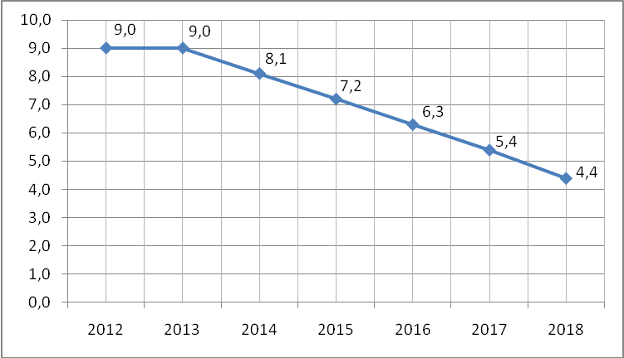
Picture 18 –Volumes of state support for domestic agriculture, agreed by Russia upon its accession to WTO, bln. $

Slide 47
Russia’s accession to WTO: main threats & opportunities (cont.)
However, the “secret” of success of foreign farmers on the Russian market is not only in the unique high quality of their production.
Agriculture in global economics is one of the most protected and “closed” branches.
The main method of protection is to give a huge volume of subsidies to the agricultural producers.
Half of “agricultural” expenses of WTO member countries are the measures distorting trade and production which has a negative influence on the global agricultural market, leading to the excess production and fall of prices for agricultural and food products
Obviously, new WTO members and developing countries can not support their agriculture equally to the USA, EU and other developed countries.
This is also the case of Russia where the volume of Amber Box support is almost 10 times lower than in EU and even lower than in Japan – country without any essential land resources and opportunities to develop its own agricultural production

Slide 48
Picture 19 –Comparison of Amber Box support volumes in Russia and WTO countries in 2011

Slide 49
Main problems of developing country on the way to trade integration:
Lowering competitiveness of domestic agriculture on the international and domestic markets (at least during first years after WTO accession).
Integration of agrarian markets into the inter-regional market and establishment of the common agrarian market (CIS, V4, etc.).
Scientific provision of accession processes and further membership in WTO.

Slide 50
Conclusions:
In the mid-term, the structure of EU-27-CIS foreign trade turnover will not get changed significantly.
CIS-EU trade flow will primarily consist of raw commodities. Its largest constituent will remain oil.
There will be also relevant (but not comparable to oil in their sizes) shares of pipeline gas, coal, petrochemicals and iron ore.
CIS deliveries would be mainly formed by Russia.
Ukraine and Kazakhstan would also become big suppliers.
The main CIS importer among EU-27 countries will be Germany, followed by Italy.
The Netherlands and Poland will increase their shares in EU-27 imports from CIS countries

Slide 51
Conclusions (cont.):
Export of agricultural products from EU-27 to CIS countries will grow in the mid-term.
The growth will be caused by a number of reasons, particularly:
  continuing liberalization of inter-regional trade within CIS, as well as a result of multilateral EU-CIS agreements;
  Russia, which is the largest economy of the region, accessed to WTO;
  low competitiveness of CIS domestic agricultural producers comparing to EU and US farmers, supported by their governments (especially in food production and high-level food processing where added value is the largest);
  incomparably lower volumes of state support for domestic agricultural producers not only in CIS-countries, but even in Russia, that does not provide sufficient protection of inter-regional market and do not allow to develop effectively high-quality food processing and food production in CIS-countries.

Slide 52
Conclusions (cont.):
WTO and trade liberalization obviously bring a set of opportunities for an accessing country.
WTO is based on an equality of rights and obligations.
This means that EU countries are obliged to open their domestic markets for CIS agricultural and food products.
However, most of the CIS-countries, including Russia, cannot fully benefit from these opening opportunities.
The state is not able to support the massive expansion of domestic farmers to European markets.
Transition period can take long time. If CIS and Russia do not use new opportunities today, better times may not come at all.

Slide 53
Thank you!
Dr. Anna IVOLGA
Faculty of Social and Cultural Service and Tourism
Stavropol State Agrarian University
Stavropol, Russia
tel.: +7-8652-355980
e-mail: annya_iv@mail.ru

