Slide 1
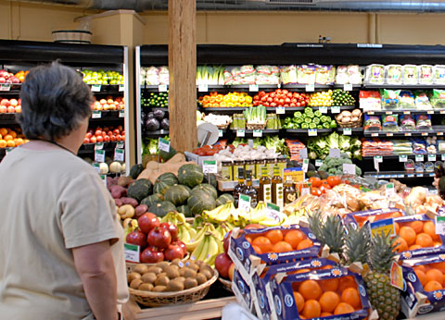
Marketing research: Implications for V4 Food market
Ing. Katarína Kleinová, PhD.
Department of marketing
Faculty of economics and management, SUA Nitra

Slide 2
Marketing research
Source: http://www-rohan.sdsu.edu/~renglish/370/notes/chapt08/

Slide 3
Types of marketing research
Secondary research
Basic research
Applied research
Qualitative research
Quantitative research
Primary research
Ad hoc research
Continuous research
Source: Fahy, J. – Jobber, D. 2006. Foundations of marketing.

Slide 4
Types of marketing research
Customer research
Advertising research
Sales research
Environment research
Product research
Distribution research
Source: Blythe, J. 2006. Principles & practice of marketing.

Slide 5
10 things to think about when considering a market research project
1
Ask yourself why the market research is needed
2
Ask around to find out if your company already has any reports in this area
3
5
6
8
9
10
Find out if there are any published studies in this field which can be purchased
Prepare a written brief
If you think that the research requires external help – talk to a couple agencies
Allow at least one week for the agency to come back with its proposals
Choose your agency on the basis of who you think can best carry out the work
Be prepared to personally explain to those agencies that haven´t got the job why the business has gone elsewhere
Hold a commissioning meeting with the winning agency and arrange milestones and reporting sessions
4
If you know anyone who has commissioned market research of this type before, ask for their advice
7
Source: Hague, P. A practical guide to market research. [online]

Slide 6
The marketing research process
Define the problem and research objectives
Develop the research plan
Collect information
Analyse the information
Present the findings
Make the decision
Source: Kotler, P. et. al. 2009. Marketing management

Slide 7
Data collection methods used in marketing research
Focus groups
Surveys
Personal interviews
Projective techniques
Observation
Experiment
Mystery shopping
Panel

Slide 8
Reasons of observing the country of origin when buying food
Source: Own marketing research

Slide 9
The impact of country of origin on consumer behavior
Type of food | 1 | 2 | 3 | 4 | 5
Food in general | 28.61 | 23.99 | 23.21 | 6.49 | 17.70
Dairy products | 44.98 | 24.21 | 13.29 | 4.63 | 12.89
Meat products | 45.43 | 22.52 | 12.39 | 5.12 | 14.54
Bakery goods | 47.20 | 19.96 | 12.39 | 5.11 | 15.34
Sweets | 15.04 | 22.32 | 27.24 | 11.21 | 24.19
Non-alcoholic beverages | 16.22 | 17.99 | 25.07 | 11.01 | 29.71
Wine | 25.17 | 24.16 | 21.69 | 6.63 | 22.35
Beer | 28.08 | 27.16 | 19.10 | 5.75 | 19.91
Source: Own marketing research

Slide 10
Motives for buying Slovak food
Buying decisions for Slovak foodstuffs
Cognitive processes
Normative processes
Affective processes
Taste
Freshness
Price
Short
distribution
Employment
support
Tradition
Feelings
Brand
Origin
Environment
Motherland
Source: Own marketing research

Slide 11
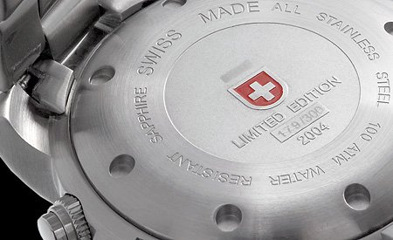
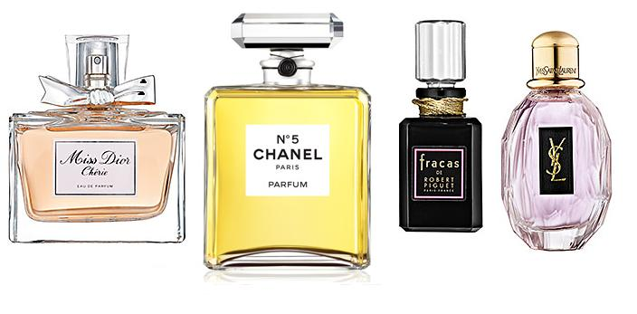
Image
Functions of image in terms of the consumer are:
simplification of reality
orientational function
function of additional benefit
function of identifying oneself, prestige and value statement.

Slide 12
Country image
The emergence of the country image can be broadly explained by the theory of learning.
„halo construct“ – „summary construct“
The factors affecting the image of the country:
product type
the level of economic maturity of the country
the impact of socio demographic and psychological criteria
consumer ethnocentrism

Slide 13
Image research
It can be dated to the 60th of the last century.
Up to the present, there were issued more than 750 publications dealing with these issues.
Limitations of image research.
Due to the complexity of the image there is no standard method of analysis.
Questionnaire (semantic differential, Likert scale, CETSCALE)
Projective techniques (word association tests, sentence completion tests, consumer drawings)

Slide 14
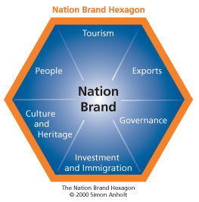
Nation Brand Hexagon
Source: http://www.gfkamerica.com/practice_areas/roper_pam/nbi_index/

Slide 15
Country Brand Index – comparison of V4 countries
 | Slovakia | Czech Republic | Poland | Hungary
Heritage ane culture | 83 | 18 | 62 | 50
Conditions for business | 47 | 39 | 38 | 59
Tourism | 79 | 55 | 80 | 83
Quality of life | 55 | 41 | 50 | 62
Value system | 47 | 34 | 43 | 59
Country total | 79 | 43 | 82 | 66
Source: http://www.futurebrand.com

Slide 16
Associations to word „Slovakia“
Category | Count | Share | The most often responses
Foodstuffs/ home kitchen | 291 | 32,5 % | Sheep cheese (107/12) Alcohol (18/2) Beer (34/3,75)
Nature | 250 | 28,0 % | The Tatras (161/18) Lakes/rivers (12/1,3)
Motherland | 212 | 23,75 % | Motherland (174/19,5) Beautiful women (7/0,75)
Economy | 67 | 7,5 % | Quality (45/5) Unemployment (7/0,75)
Culture/history /tourism | 45 | 5,0 % | Traditions (11/1,2) Culture (20/2,2) Bratislava (5/0,6)
Politics | 29 | 3,25 % | Politic leaders (18/2)
Total | 894 | 100 %
Source: Own marketing research

Slide 17
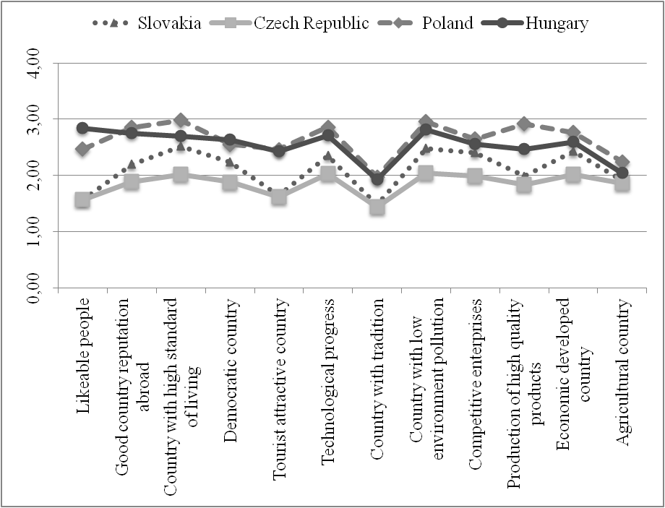
Country image
Source: Own marketing research

Slide 18
Food image
Spontaneous association of the term „Slovak and foreign food“
Typical food and preference of food from selected countries
Image of Slovak and foreign foods

Slide 19
Associations to „typical products“ from V4 countries
Food | Slovakia |  | Czech Republic |  | Poland |  | Hungary
 | count | share | count | share | count | share | count | share
Dairy products | 1119 | 59,2% | 109 | 8,2% | 101 | 10,3% | 4 | 0,3%
Meat products | 51 | 2,7% | 79 | 5,9% | 71 | 7,2% | 545 | 41,8%
Bakery products | 62 | 3,3% | 19 | 1,4% | 9 | 0,9% | 7 | 0,5%
Sweets | 72 | 3,8% | 96 | 7,2% | 664 | 67,8% | 10 | 0,8%
Alcoholic drinks | 416 | 22,0% | 869 | 65,1% | 46 | 4,7% | 257 | 19,7%
Nonalcoholic drinks | 136 | 7,2% | 63 | 4,7% | 31 | 3,2% | 7 | 0,5%
Fruit/vegetables | 35 | 1,8% | 15 | 1,1% | 58 | 5,9% | 363 | 27,8%
Total | 1891 | 100% | 1335 | 100% | 980 | 100% | 1305 | 100%
Source: Own marketing research

Slide 20
Knowledge of brands
Food | Slovakia |  | Czech Republic |  | Poland |  | Hungary
 | count | share | count | share | count | share | count | share
Dairy products | 670 | 33,2% | 127 | 11,1% | 12 | 5,7% | _ | _
Meat products | 131 | 6,5% | 74 | 6,5% | 8 | 3,7% | 254 | 64,8%
Bakery products | 18 | 0,9% | _ | _ | _ | _ | _ | _
Sweets | 722 | 35,8% | 327 | 28,7% | 177 | 83,2% | _ | _
Alcoholic drinks | 264 | 13,1% | 535 | 46,9% | 8 | 3,7% | 128 | 32,7%
Nonalcoholic drinks | 152 | 7,5% | 44 | 3,9% | _ | _ | _ | _
Others | 61 | 3,0% | 33 | 2,9% | 8 | 3,7% | 10 | 2,5%
Total | 2018 | 100% | 1140 | 100% | 213 | 100% | 392 | 100%
Source: Own marketing research

Slide 21
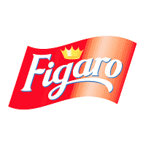
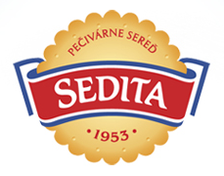
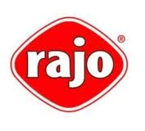
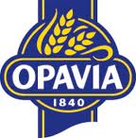
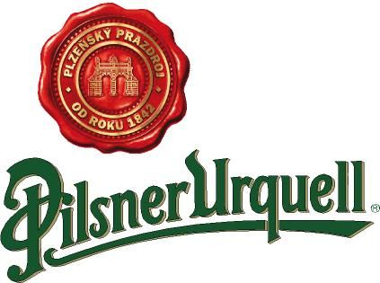
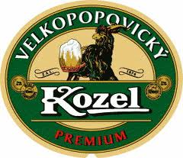
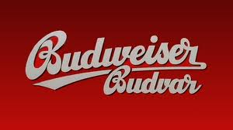
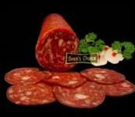
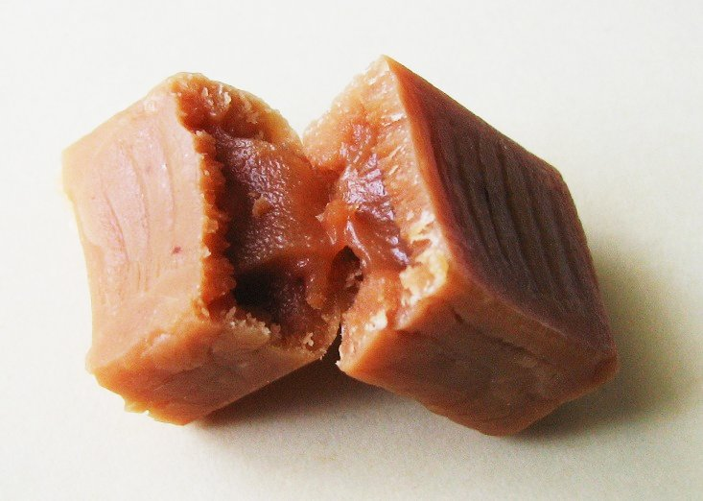
Slovak food brands
Czech food brands
Hungarian food brands
Polish food brands

Slide 22
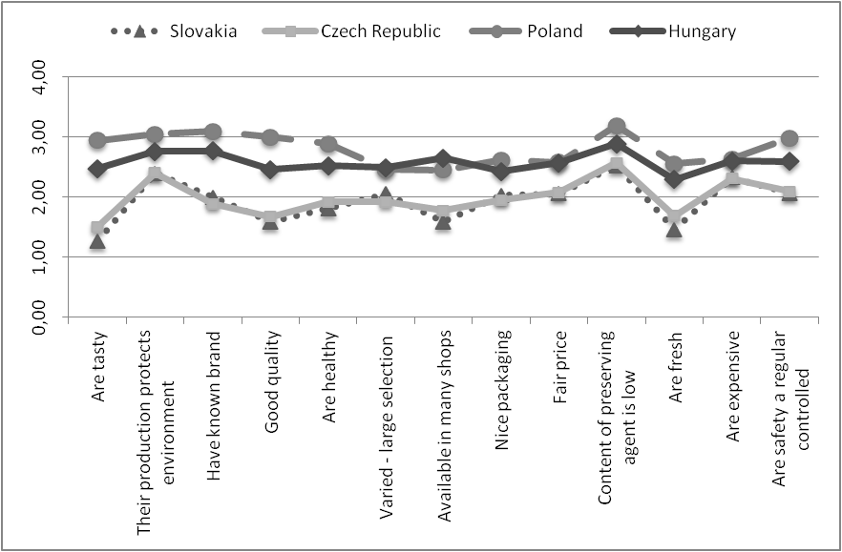
Image of Slovak, Czech, Polish and Hungarian food
Source: Own marketing research

